Slide 1




THINK BEYOND THE VISUAL
UX Hackday 2018
Team Name: THE IMPECCABLES
F9-Hyderabad

Slide 2
billberry
App Name
A One Stop Application For All Client Invoices

Slide 3
Billberry App For Clients
Category : Cognitive UX
Premise of Idea : A One Stop Application For All Client Invoices
Audience : ADP Clients
Team Members : Bala Toleti
Venkata Penamakuri
Chinthamadaka Raghavendra
Rahul Prasad
Sana Nazreen

Slide 4








Introduction
Invoice Delivery
EVERY FRIDAY
Clients
Delivery
Methods
88% of the Clients
receive invoices through Email
delivery method
Email
More than
400,000
Invoices are generated
every Friday...
12% of the Clients have opted for a hard copy of
invoices through US Postal Mail delivery method
USPS Mail
Source: Data collected from Order to Cash Application serving US Clients.

Slide 5






In The Next Few Days..
Payment Methods
Remittance files are sent from the Banks to ADP after the payments are done.
Receipts are generated.
Clients
Cheques
PNC / CITI Banks
SAN DIMAS
Direct Debit
Funds
Source: Data collected from Order to Cash Application serving US Clients.

Slide 6




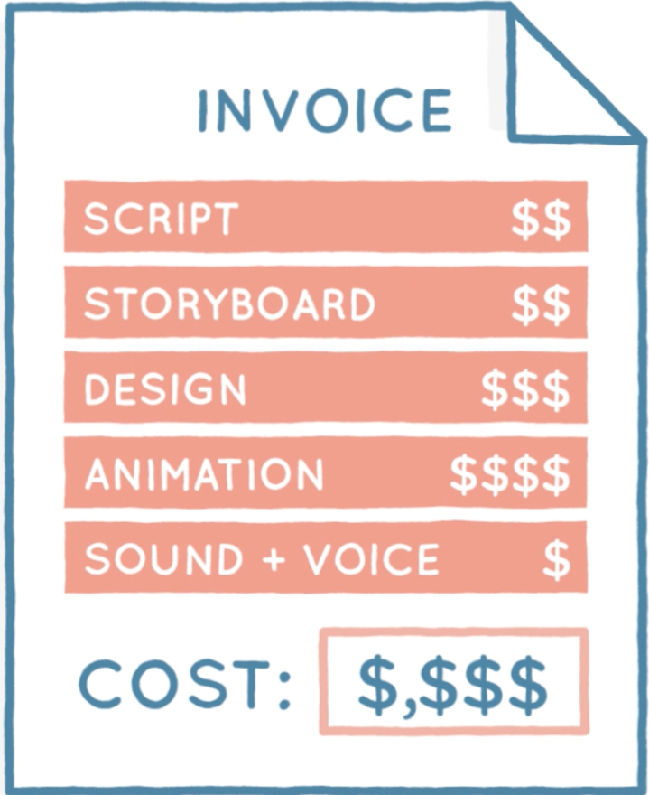

Disputes Creation
There seems to
be an error in my Invoice..
Service Desk Ticket Created
Average call time
20-40 mins
IR Reps
Operations Team
IR Rep reconfirms the issues
Query the details and make necessary changes
Clients call up ADP Service Centre
On an Average
24-48 Hours
taken to resolve each ticket
ADP Order to Cash System
Source: ES Database

Slide 7


Customer Details Changes
I want to change my contact details..
Service Desk
Ticket Created
Average call time
20-40 mins
IR Reps
Contact Info
Operations Team
IR Rep reconfirms the issues
Query the details and make necessary changes
Clients call up ADP Service Centre
On an Average
3-5 Business Days taken to resolve each ticket!
ADP Order to Cash System
Source: ES Database

Slide 8

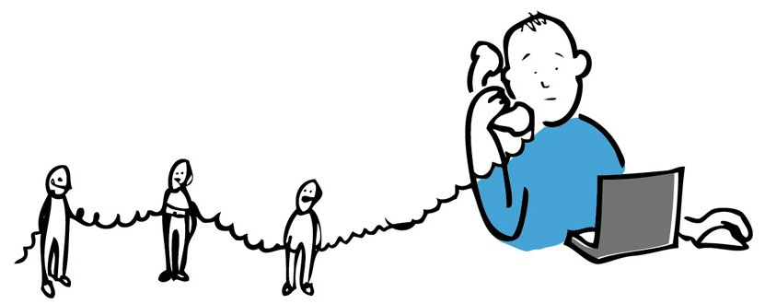
There is an impact on the NPS Score
Multiple Hops for the issue to be resolved
Client
IR Rep
Supervisor
IR Rep
Operations Team

Slide 9

NUMBER OF CALLS PER MONTH
(ON AN AVERAGE)
4000+

Slide 10



COST OF EACH CALL
ON AN AVERAGE
$6.25

Slide 11
48,000
Calls per Year
$25,000
Call costs per Month
$300,000
Call Costs per Year

Slide 12

Process flow
Client Calls ADP Service Centre
Service Centre Representative raises a Siebel Ticket
IR Rep calls the client
to re-confirm the issue
IR Representative investigates the issue
Require Invoices
Errors in Invoices
Other Invoice Issues
No Errors in Invoices
Invoices are resent
Credits are created
IR Rep calls and explains to the client that there are no discrepancies
Required actions taken

Slide 13
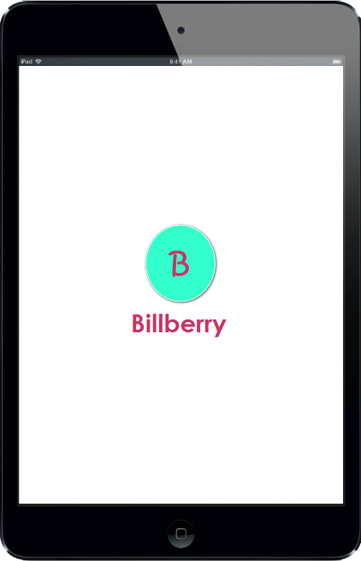
Solution

Slide 14
KEY Features of the app
This app would be a ONE STOP SHOP for all Invoice related issues
Online payments as a Benefit to our clients
Reduce the operational costs at ADP (in terms of calls/infra)
Helps in improving the client experience
Marketing campaigns (Cross Sell / Up Sell)
This idea is inline with the organization objective – SIG

Slide 15
A tool for clients..
To access their Invoices
To create Invoice Disputes and update dispute details
To view currently due Invoices
To view past history of Invoices
To update or modify client details
To view previous dates of Payments, for audit purpose, etc
To view all Credit details
To make Invoice Payments using various online payment methods
For Digital Marketing Campaigns of ADP products
For all other invoice related requests or queries
For notifying the client regarding the invoice requests

Slide 16
Benefits to Clients
Benefits to ADP
Improved process for Invoice Issues
Enhances Client Satisfaction
Reduce Clients’ efforts and save time
Client can raise disputes via app
Client can update any details via app
Reduced call costs
Reduced Service Centre Efforts
Reduced number of multiple hops
Can lead to an increase in NPS Score
Up Sell/Cross Sell ADP Products

Slide 17
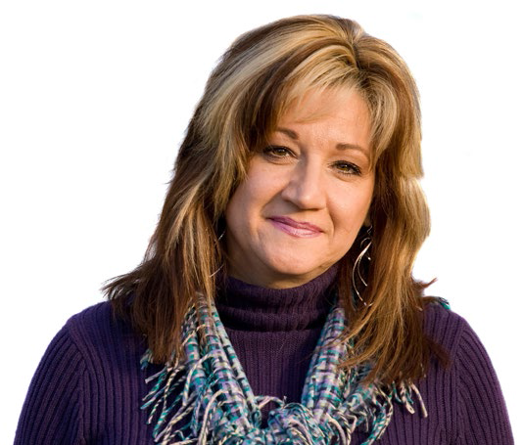



User Personas
ABCD Interiors Store Interior Designer and Owner
ANOTHER Pvt Ltd
Finance Head
Thirdo Retail Centre
Store Owner
XYZA Restaurant
Restaurant Owner

Slide 18
Demographics
Company Profile
Demographics
Company Profile
Age: 45
Practitioner Type:
Generalist
Education:
B.A.
Department Size: 3
Locations: 2
Years of Experience: 23
Age: 50
Practitioner Type:
Specialist
Education:
B.B.A./M.B.A
Department Size: 2
Locations: 8
Years of Experience: 28
ABC Interiors Store
Interior Designer & Owner
ANOTHER Pvt Ltd
Finance Head
Project Specific Quotes:
Project Specific Quotes:
“I’m not too good at math. I do not understand banking terminologies. I sometimes put things in safe places and tend to forget about them.”
“I am tech savvy.I love using mobiles. I prefer paying on the go using credit cards or other modes of online payment. I prefer typing to talking. I care about where every rupee of the company is being spent.”
Responsibilities:
Responsibilities:
Interior Decor Designing , Employee Maintenance, General, Mail, Cash Management, Customer Relationships
Financial Planning, Special Projects, Reporting, Meetings, Auditing, Analysis, Expenses, Billing, Security, Outsourcing
Needs:
Technology Traits
Needs:
Technology Traits
-An explanation about banking/product terminologies and a simplified application to use.
- A way to update contact details easily..
Low
High
-A mobile solution for all his problems
- A way to make payments online
Low
High
Confidence
Confidence
Knowledge
Knowledge
Mobile/Tablet
Mobile/Tablet

Slide 19
Demographics
Company Profile
Demographics
Company Profile
Age: 40
Practitioner Type:
Generalist
Education:
M.B.A.
Department Size: 6
Locations: 11
Years of Experience: 18
Age: 35
Practitioner Type:
Generalist
Education:
B.A.
Department Size: 1
Locations: 1
Years of Experience: 10
Thirdo Retail Centre
Store Owner
XYZA Restaurant
Restaurant Owner
Project Specific Quotes:
Project Specific Quotes:
“I usually dispose all papers after a certain amount of time. I don’t like the idea of searching for info in my mailbox. I like to explore products that are marketed in the websites. Who knows what useful stuff you may find!”
“I have recently started my own business. I am a chef and owner of a restaurant in a small town. I need the business to run on rails. I don’t like spending a long time dealing with all that paperwork. ”
Responsibilities:
Responsibilities:
Planning, Administration, Paperwork, Customer Service, Inventory management, Invoices management.
Cooking, Hiring, Ordering Food Supplies, Keep track of Bills, Insurance, Accounting, Management, Paperwork
Goals:
Technology Traits
Goals:
Technology Traits
Low
High
Low
High
- Easy way to manager paperwork and invoices.
- Find interesting items in marketing campaigns and be up to date. .
- A place to view all his invoices.
- Spend the least amount of time on searching for invoices.
Confidence
Confidence
Knowledge
Knowledge
Mobile/Tablet
Mobile/Tablet

Slide 20
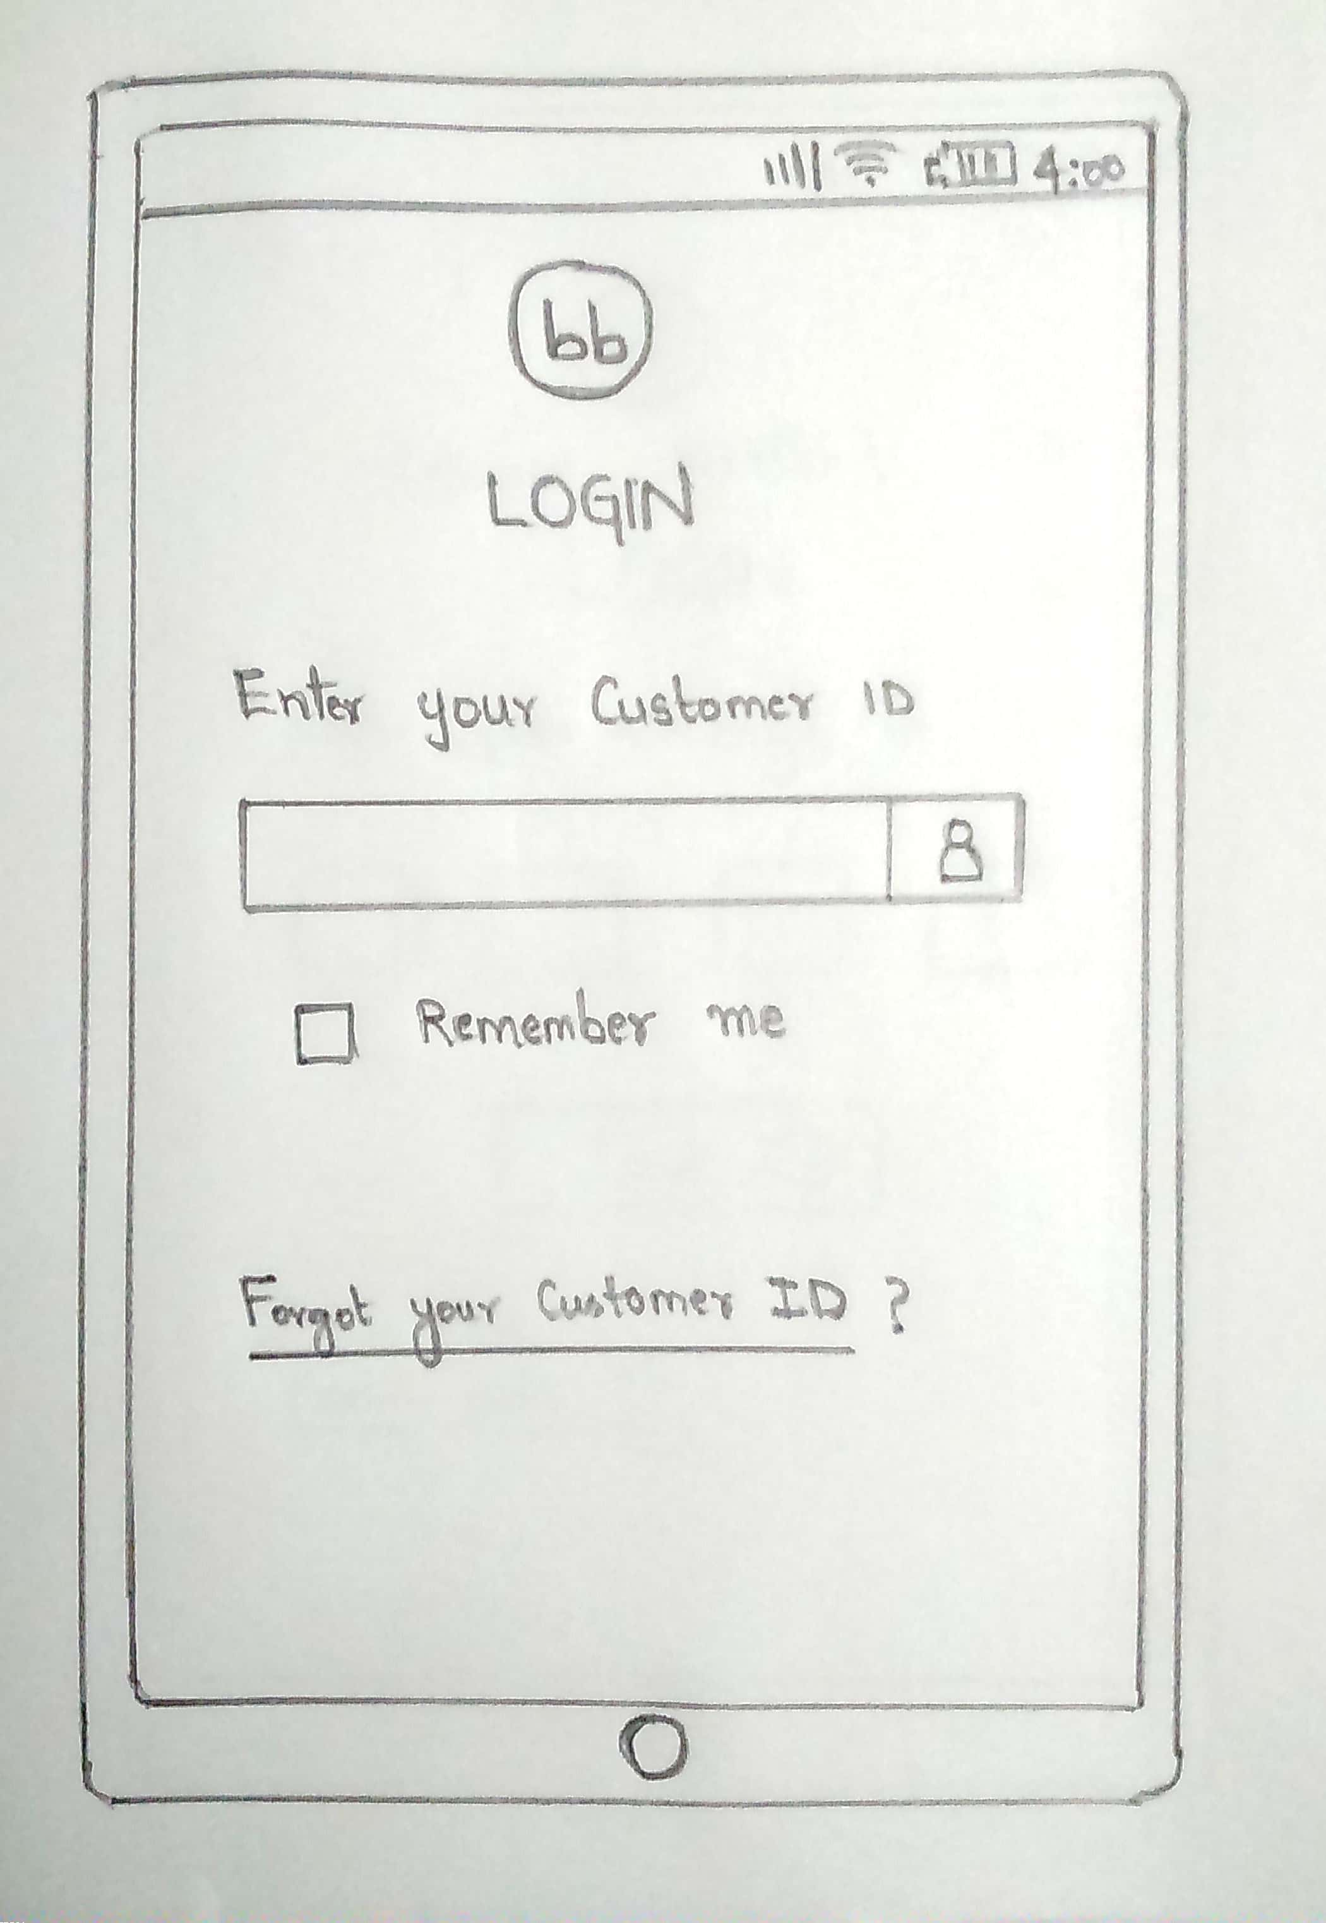
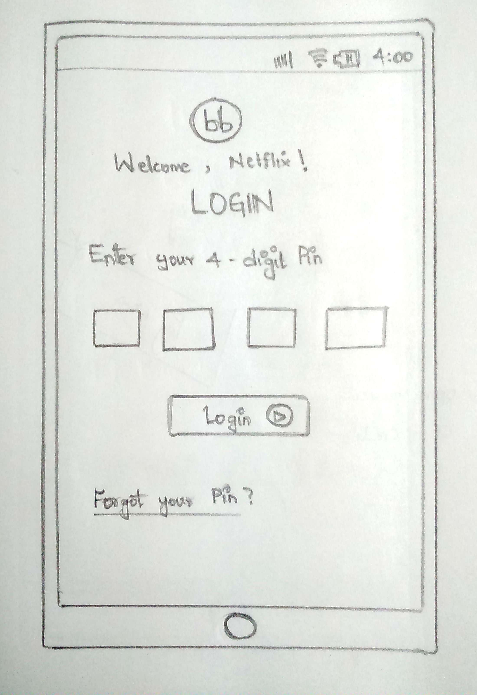
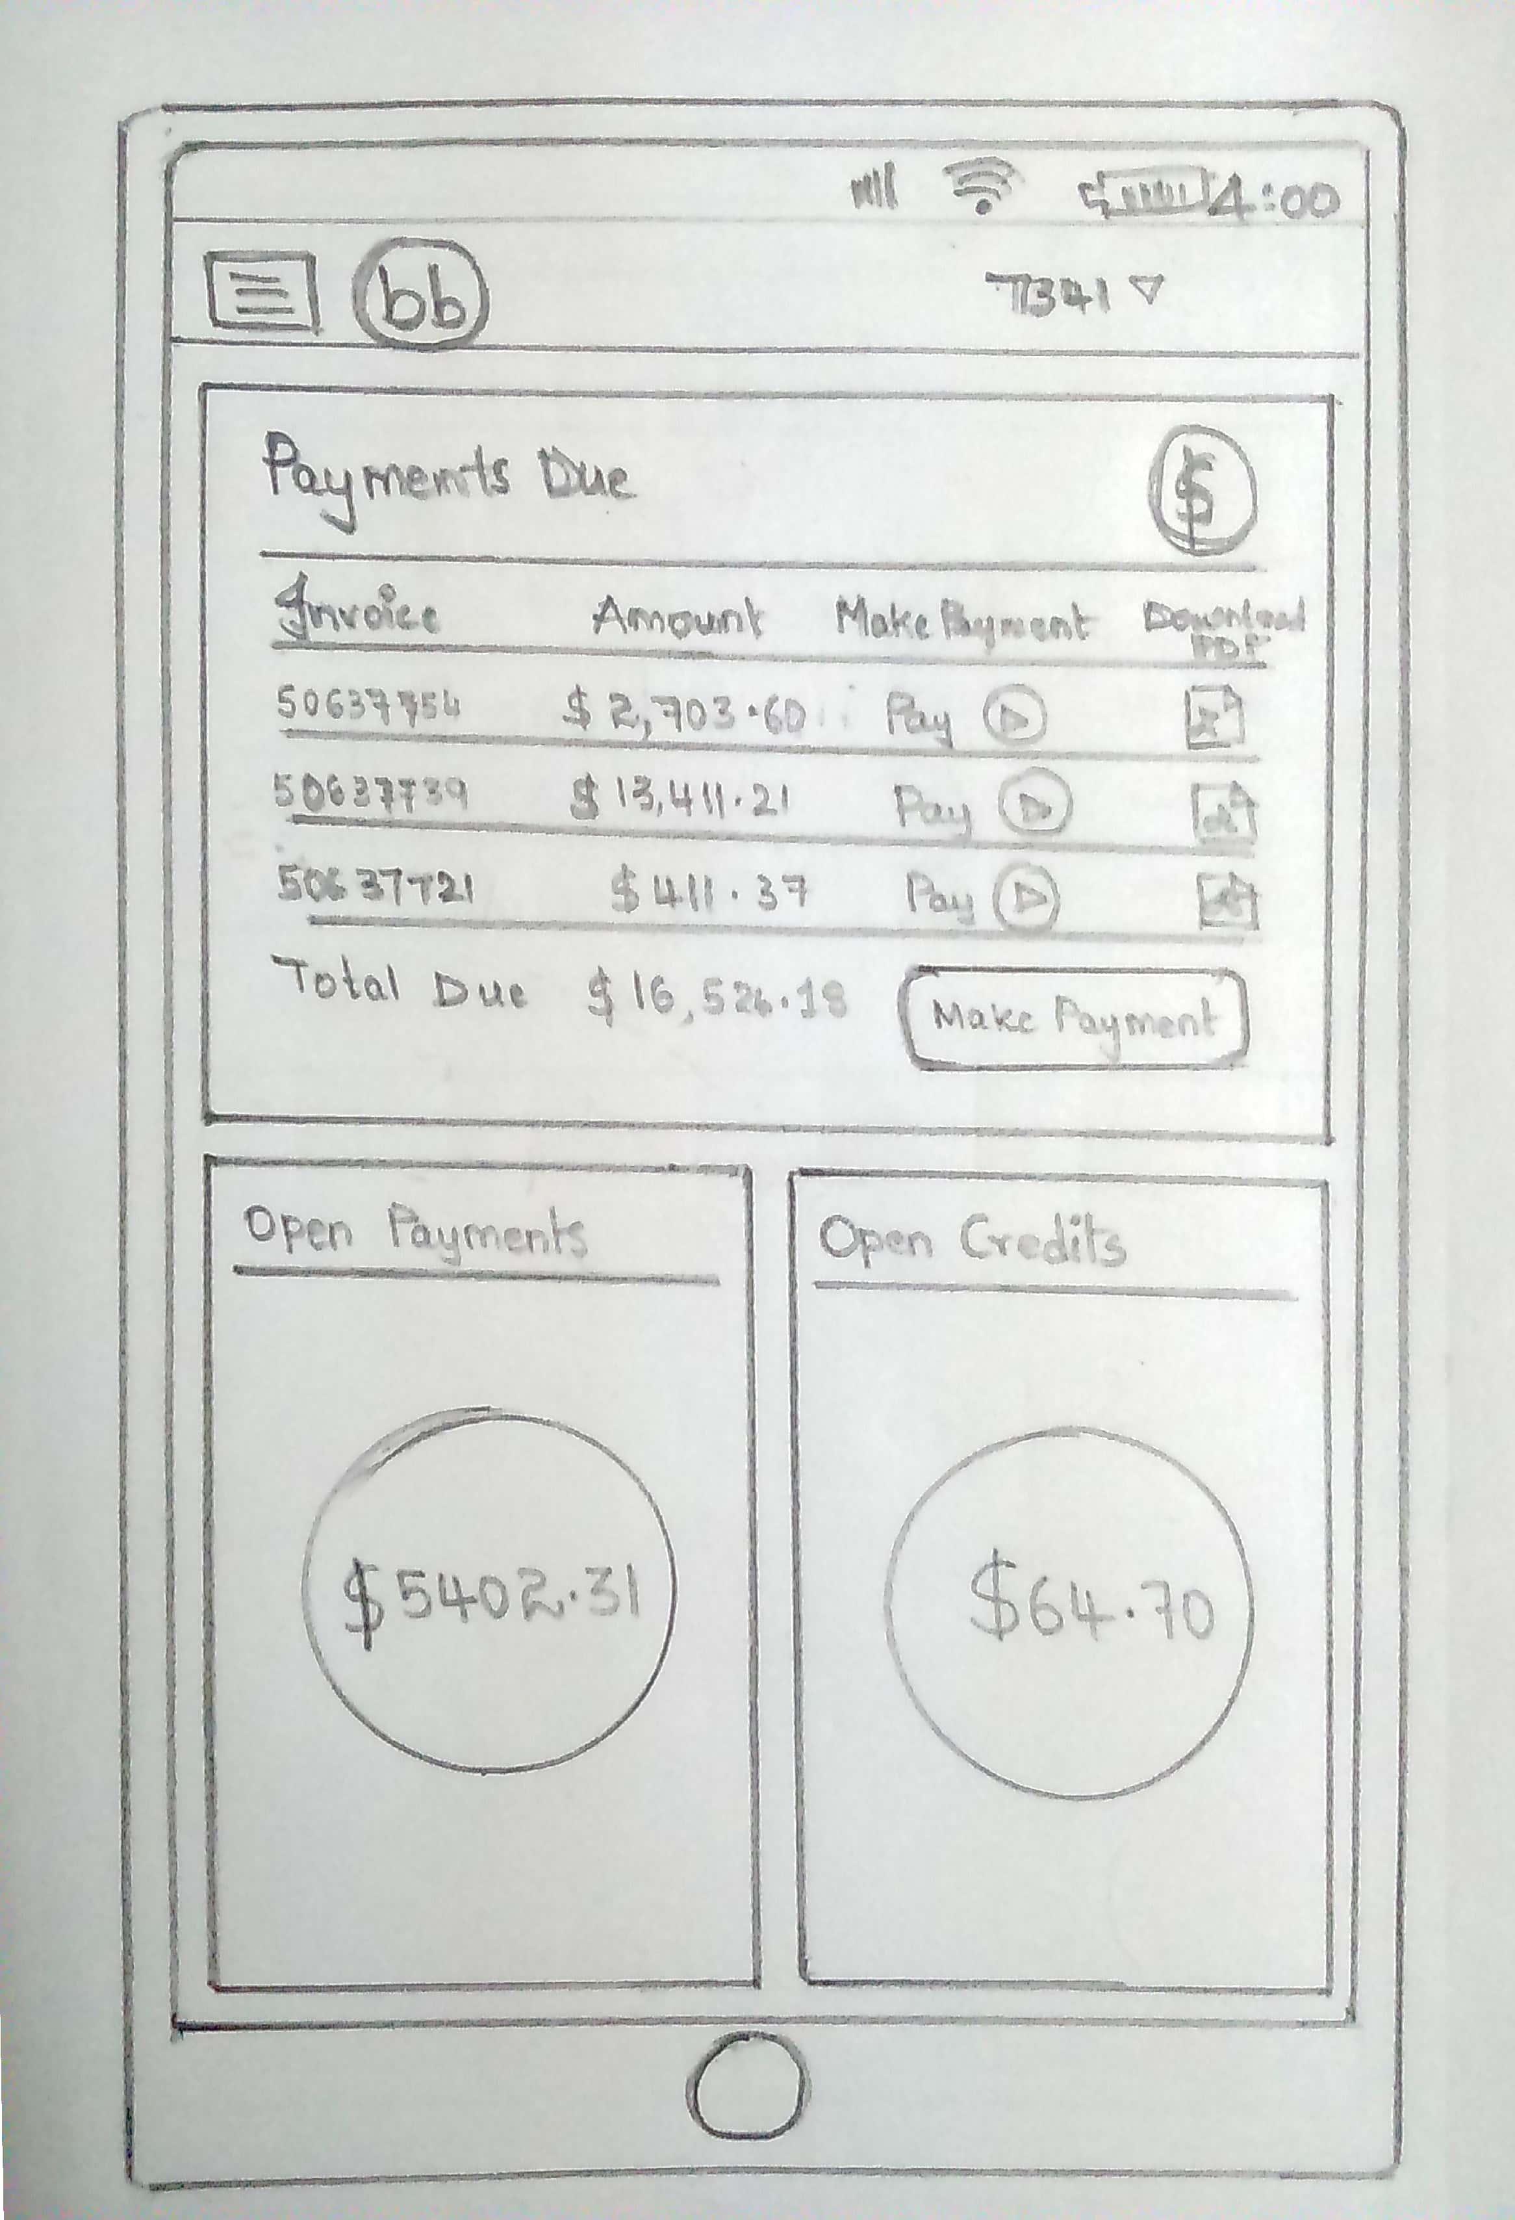
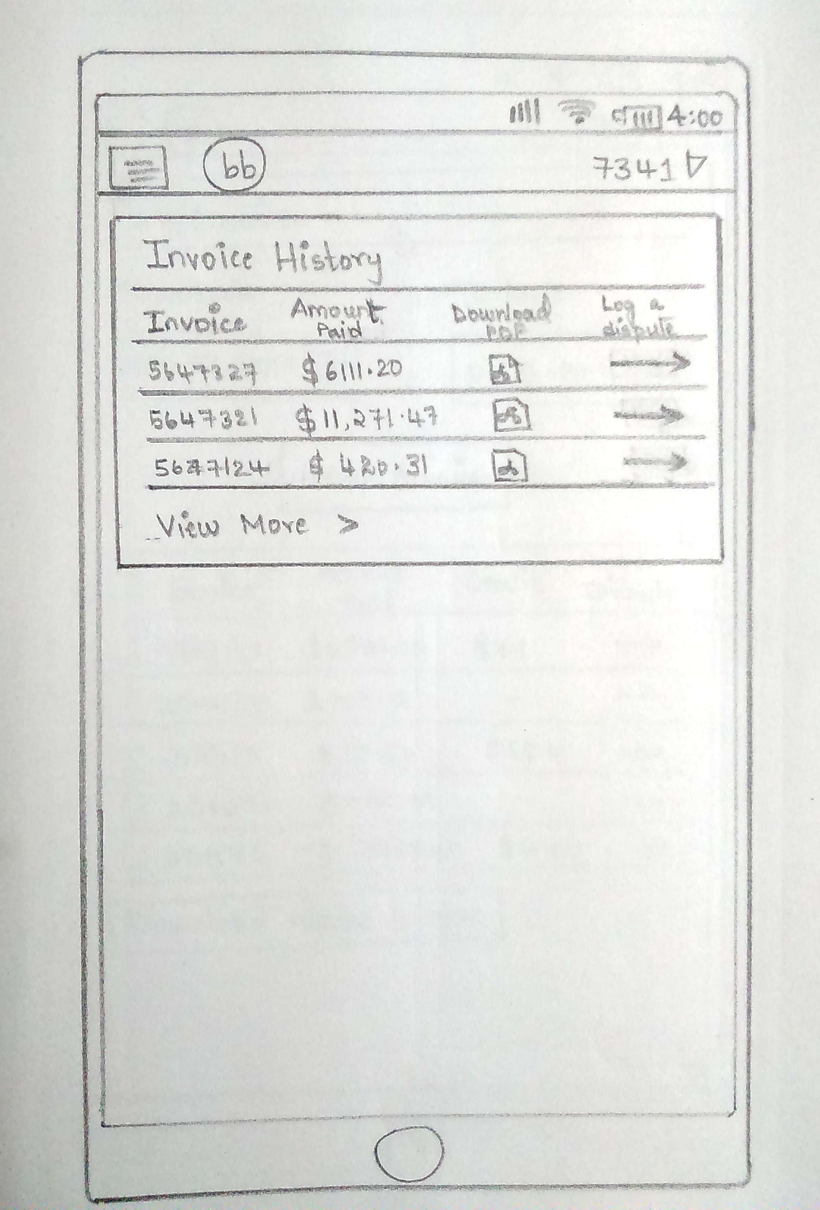
Sketches of the Screen Designs and User Flows…

Slide 21
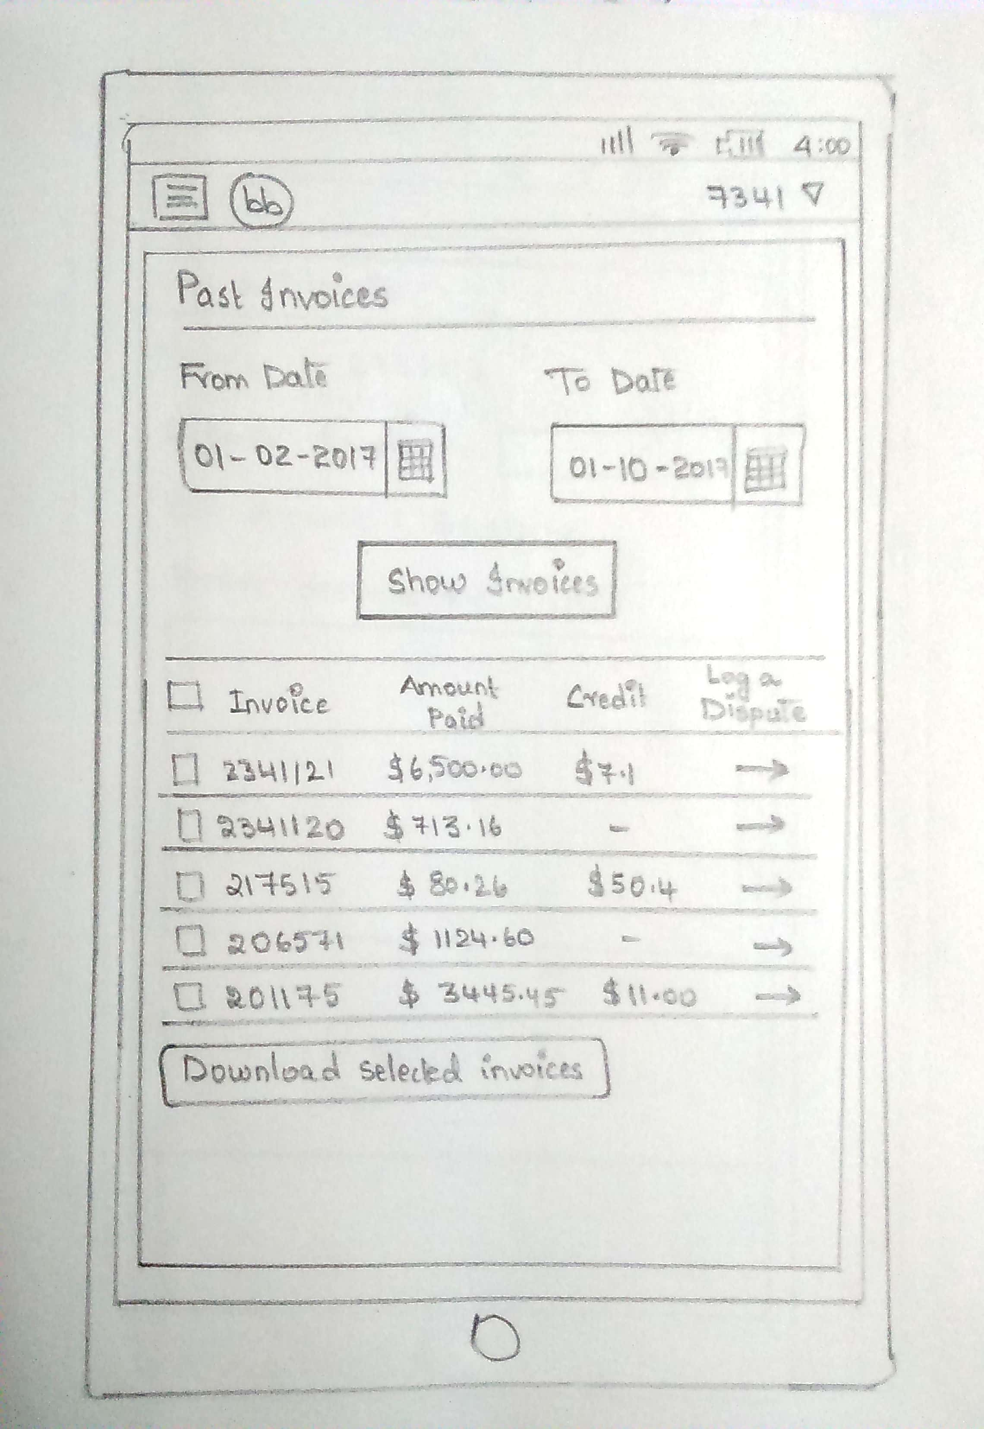
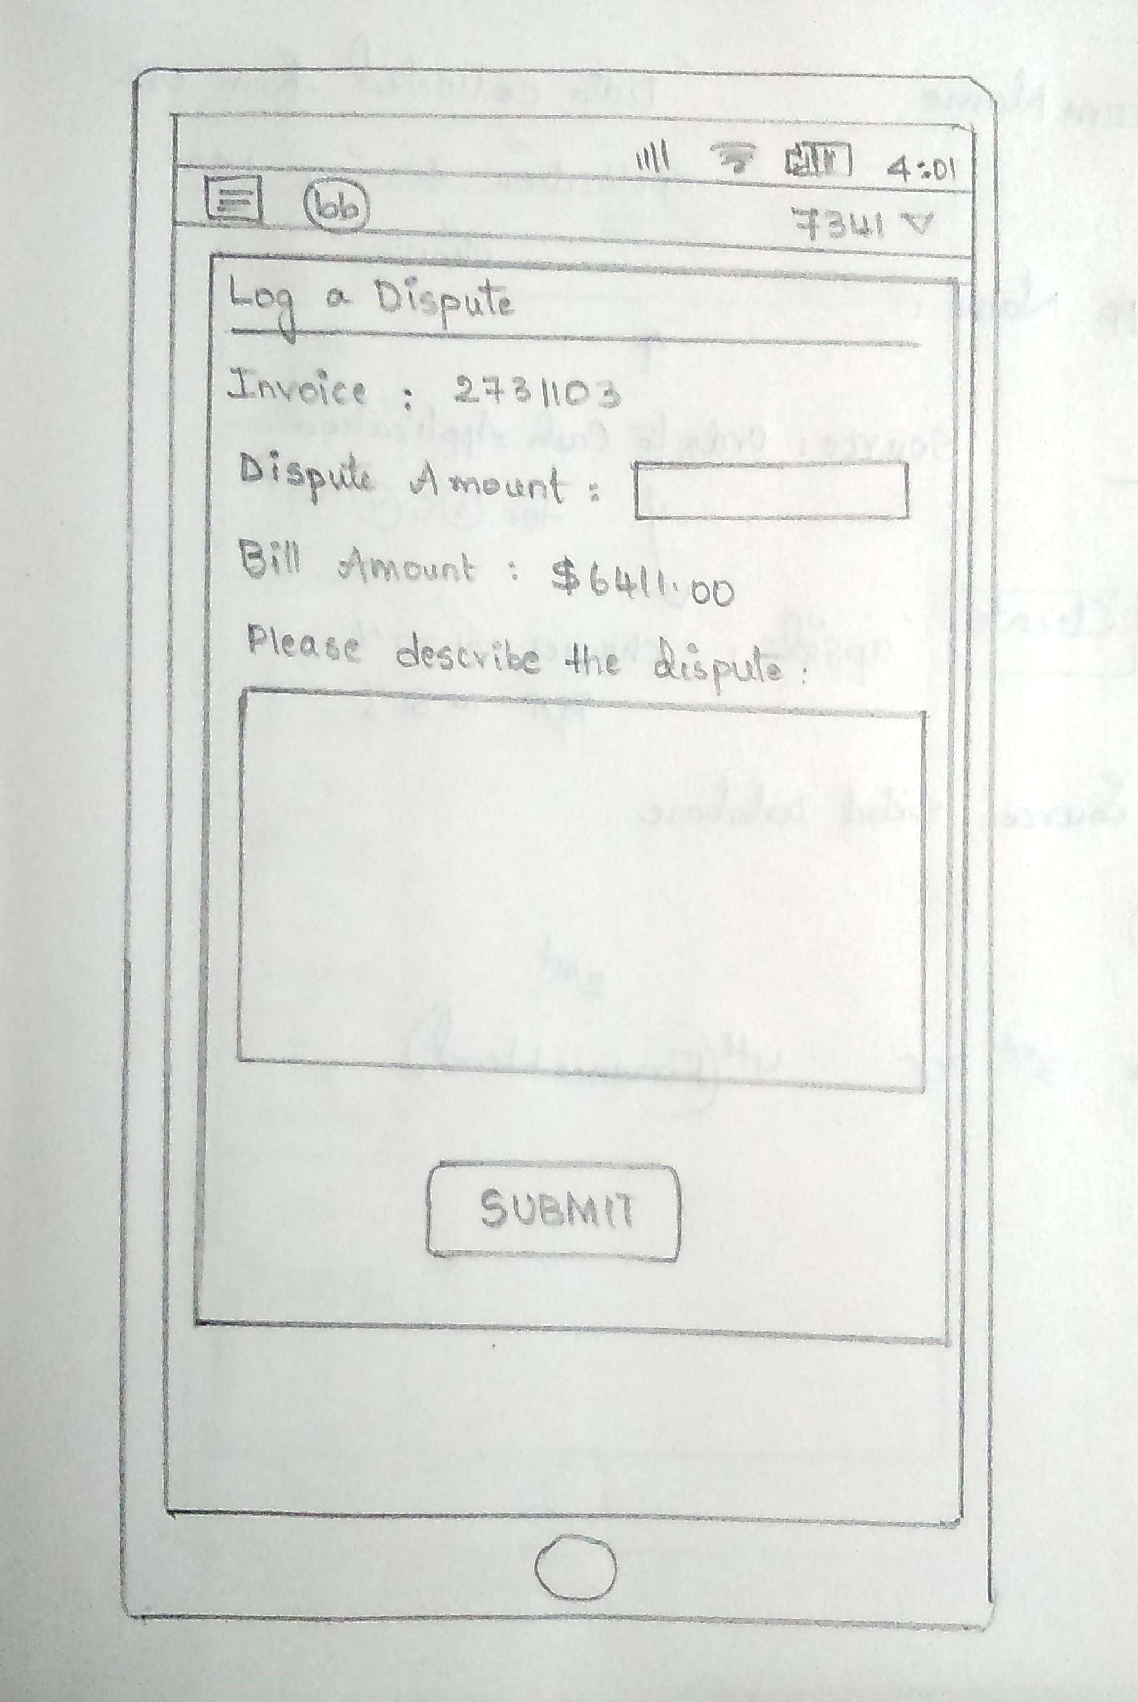
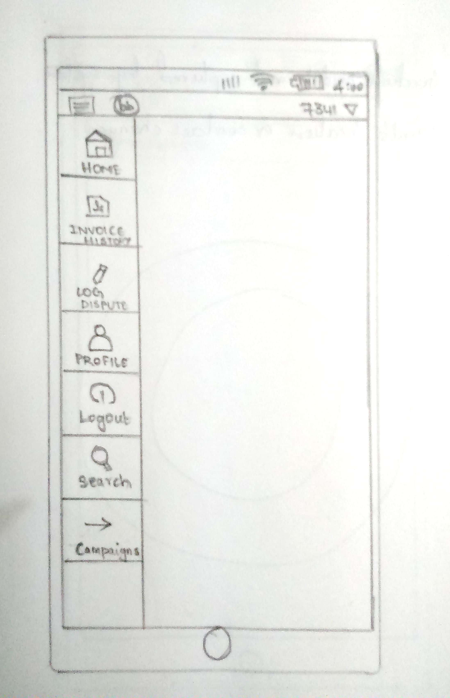
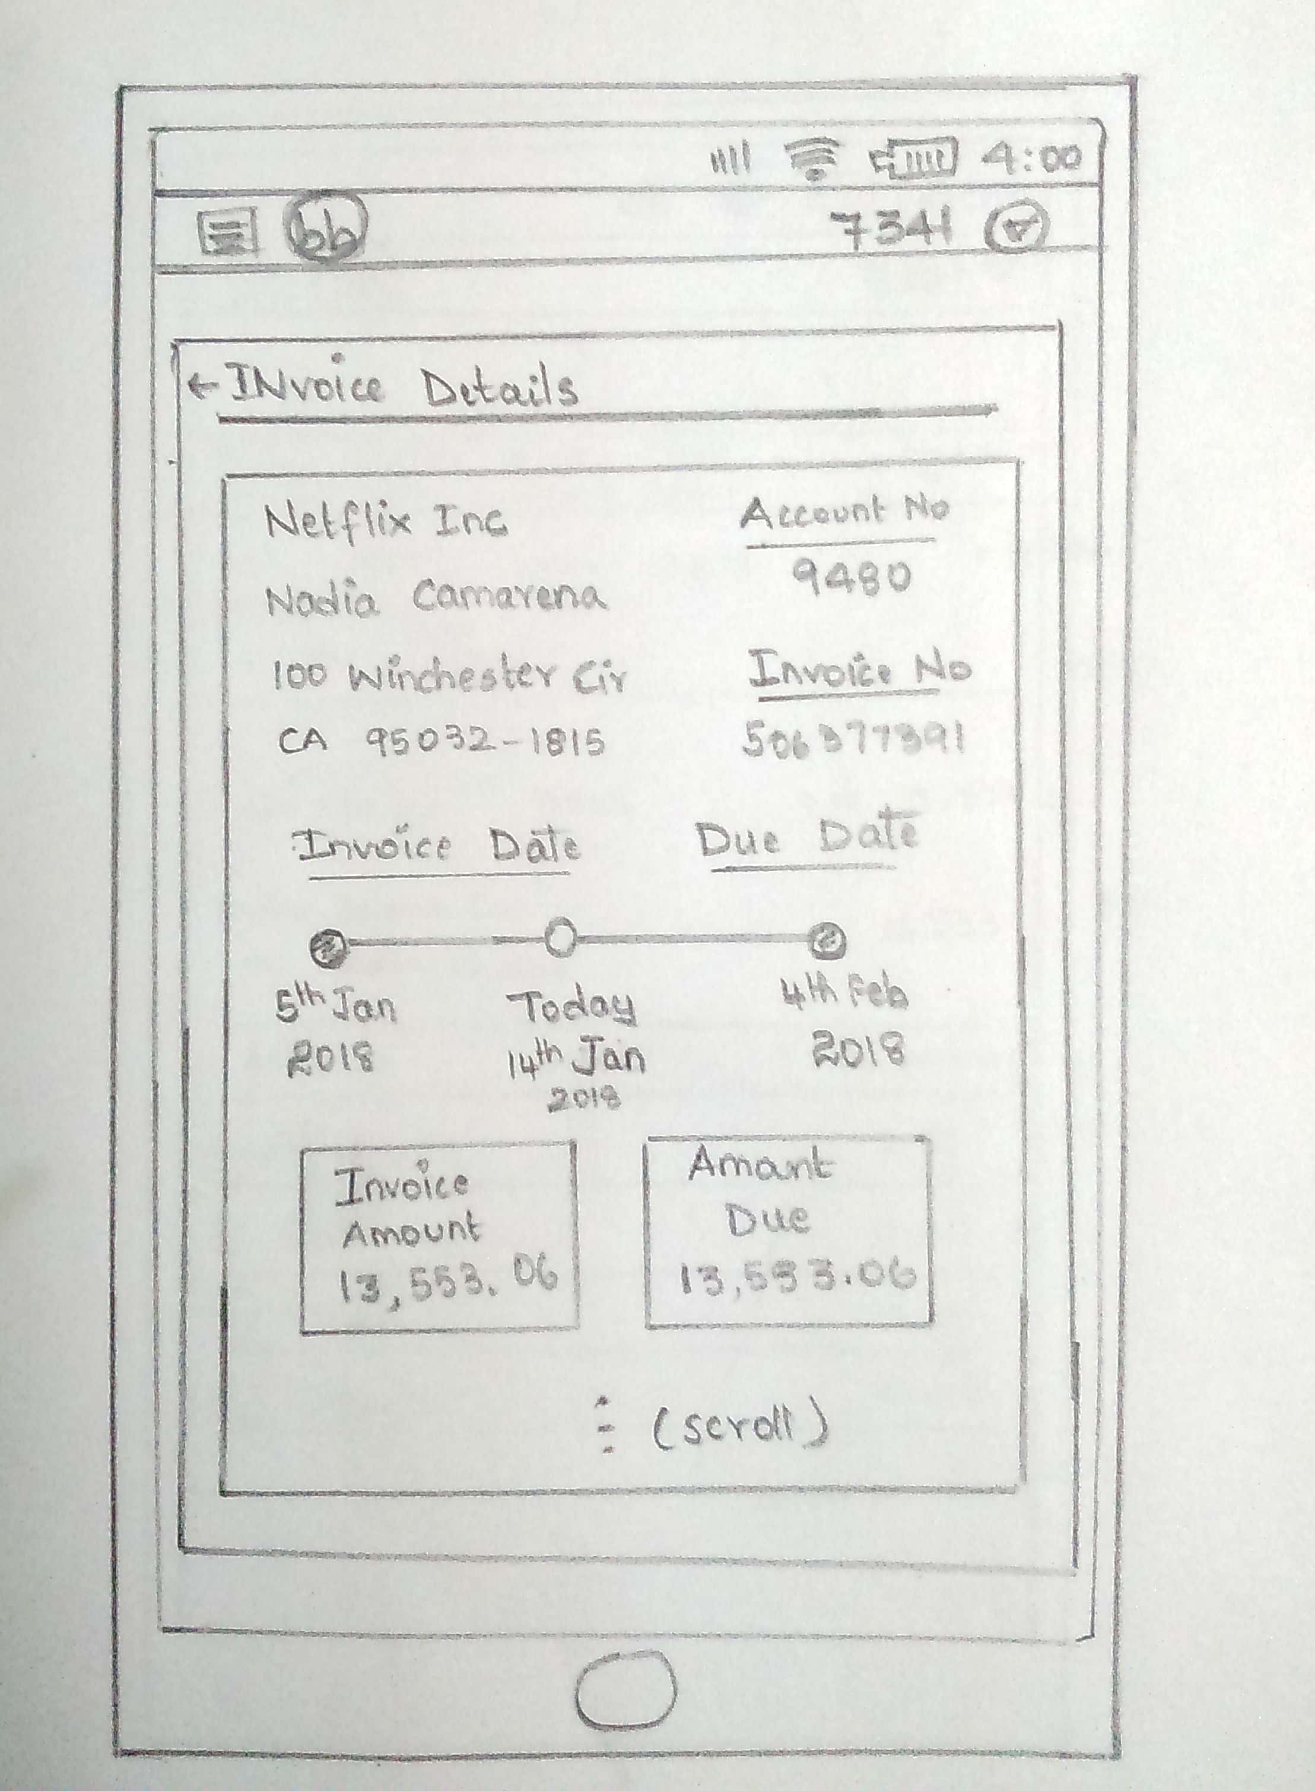
Sketches of the Screen Designs and User Flows…

Slide 22
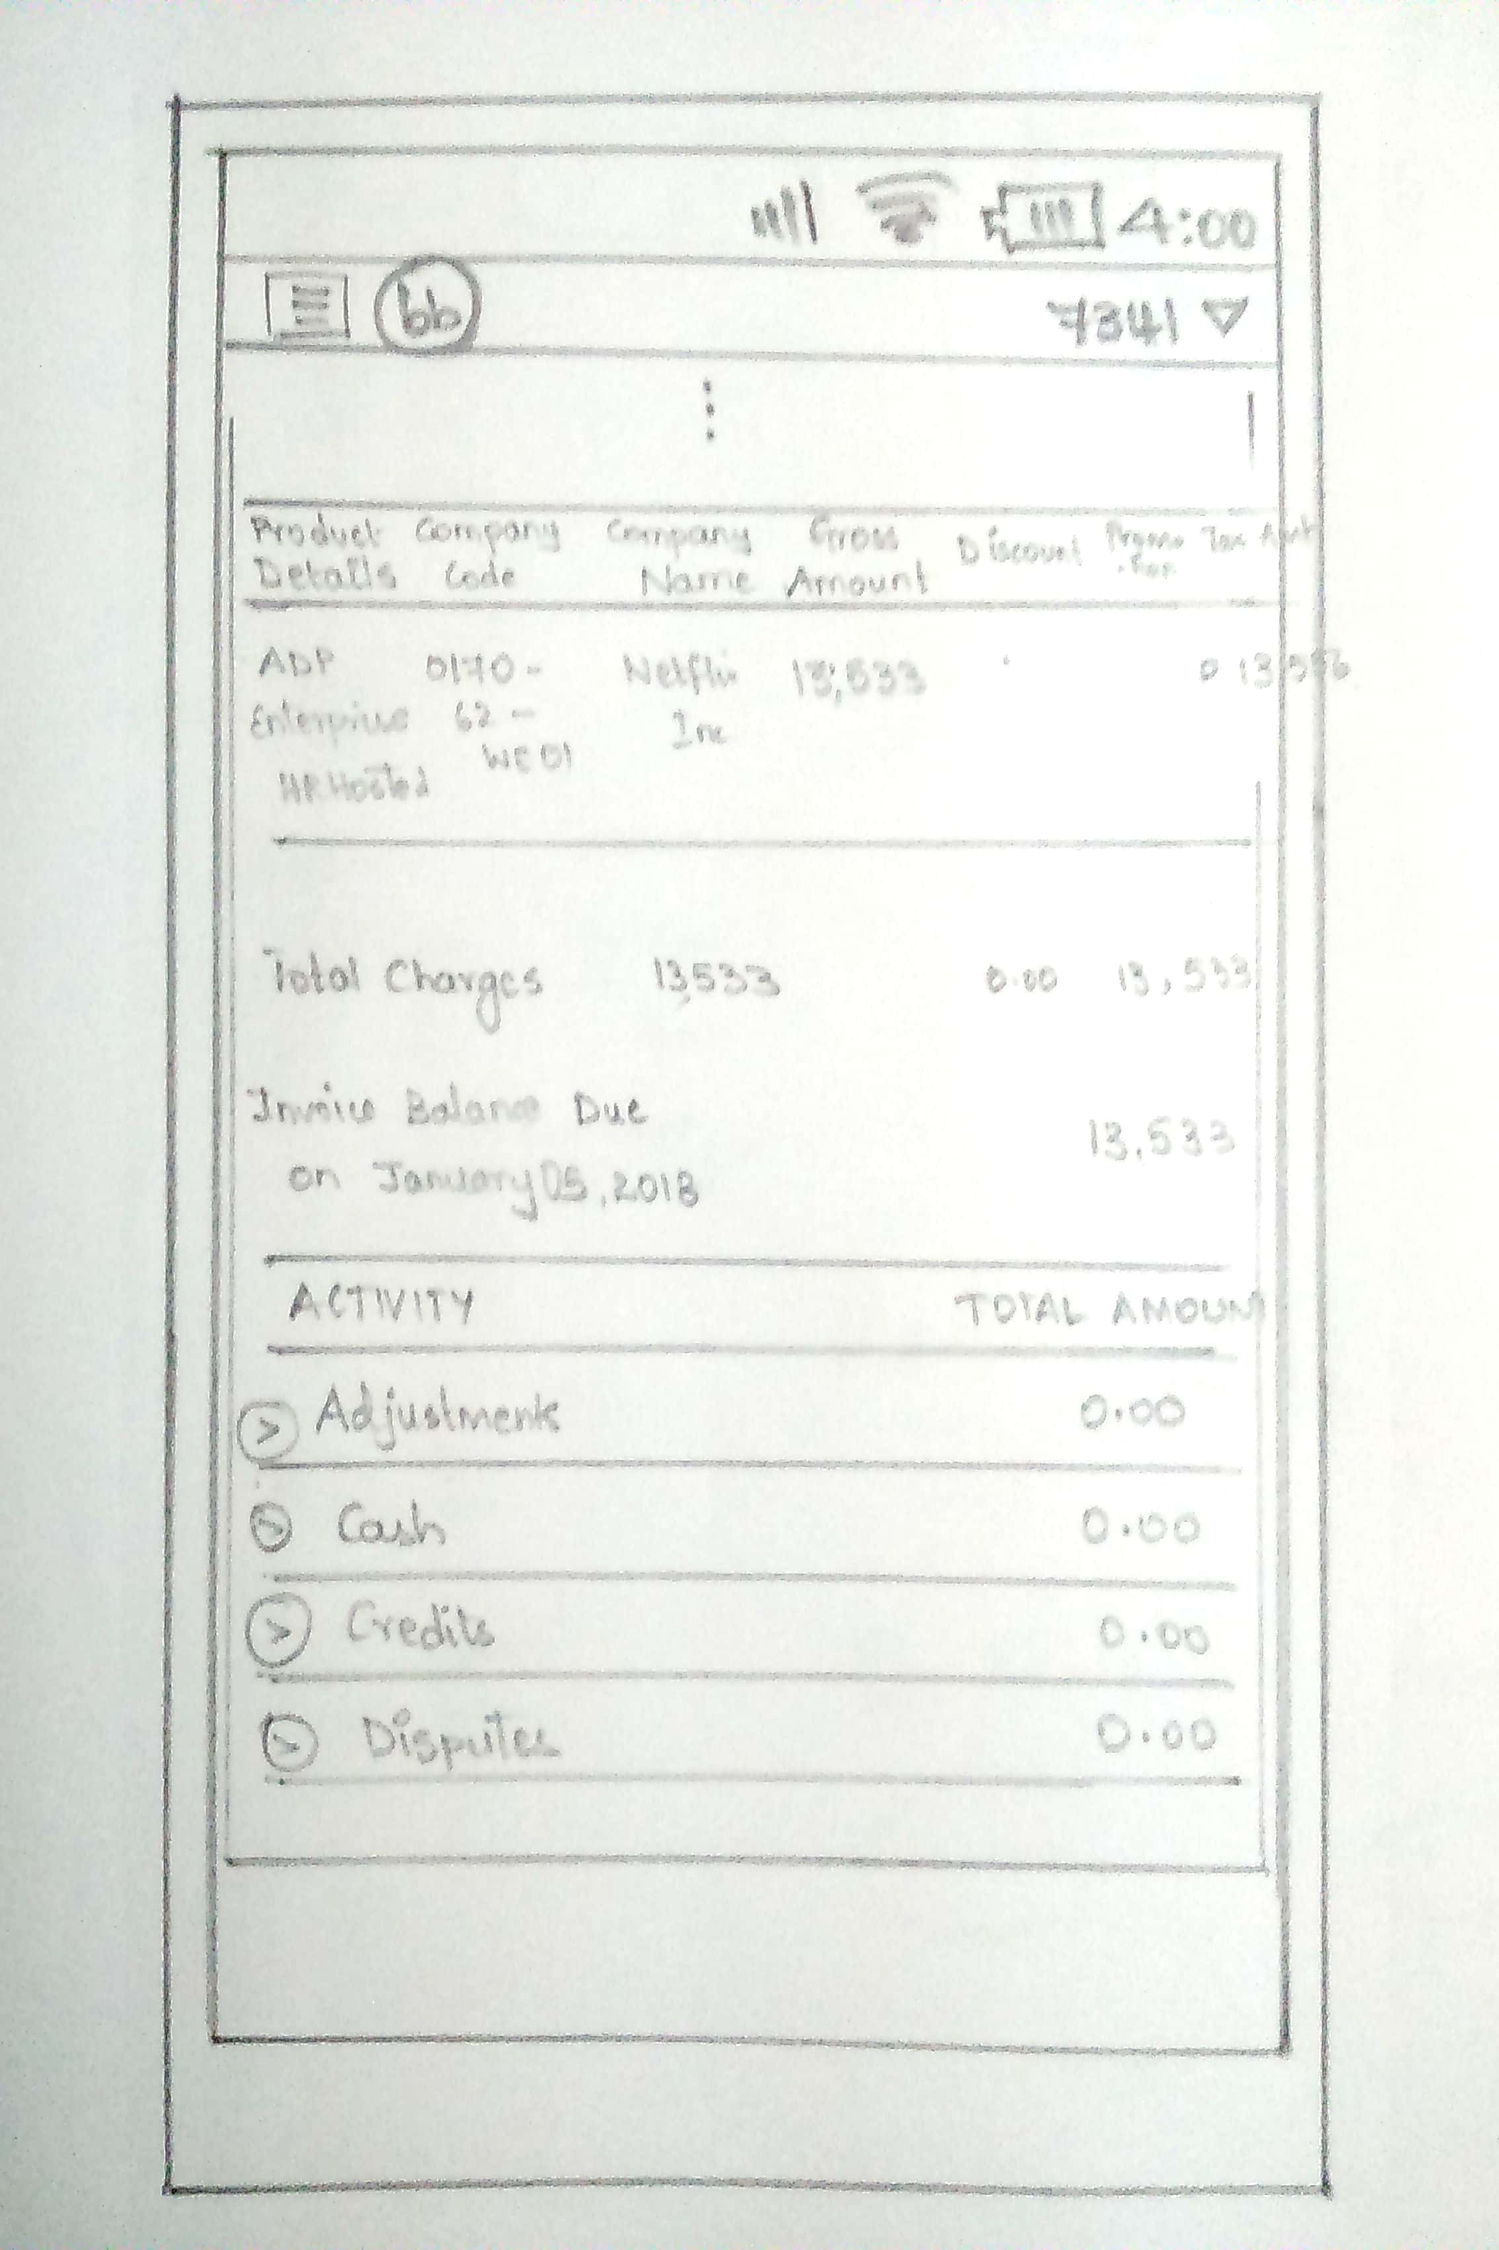
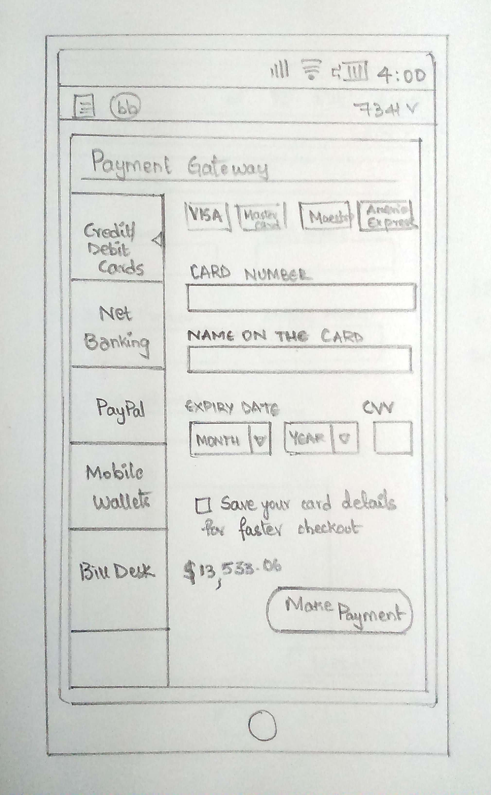
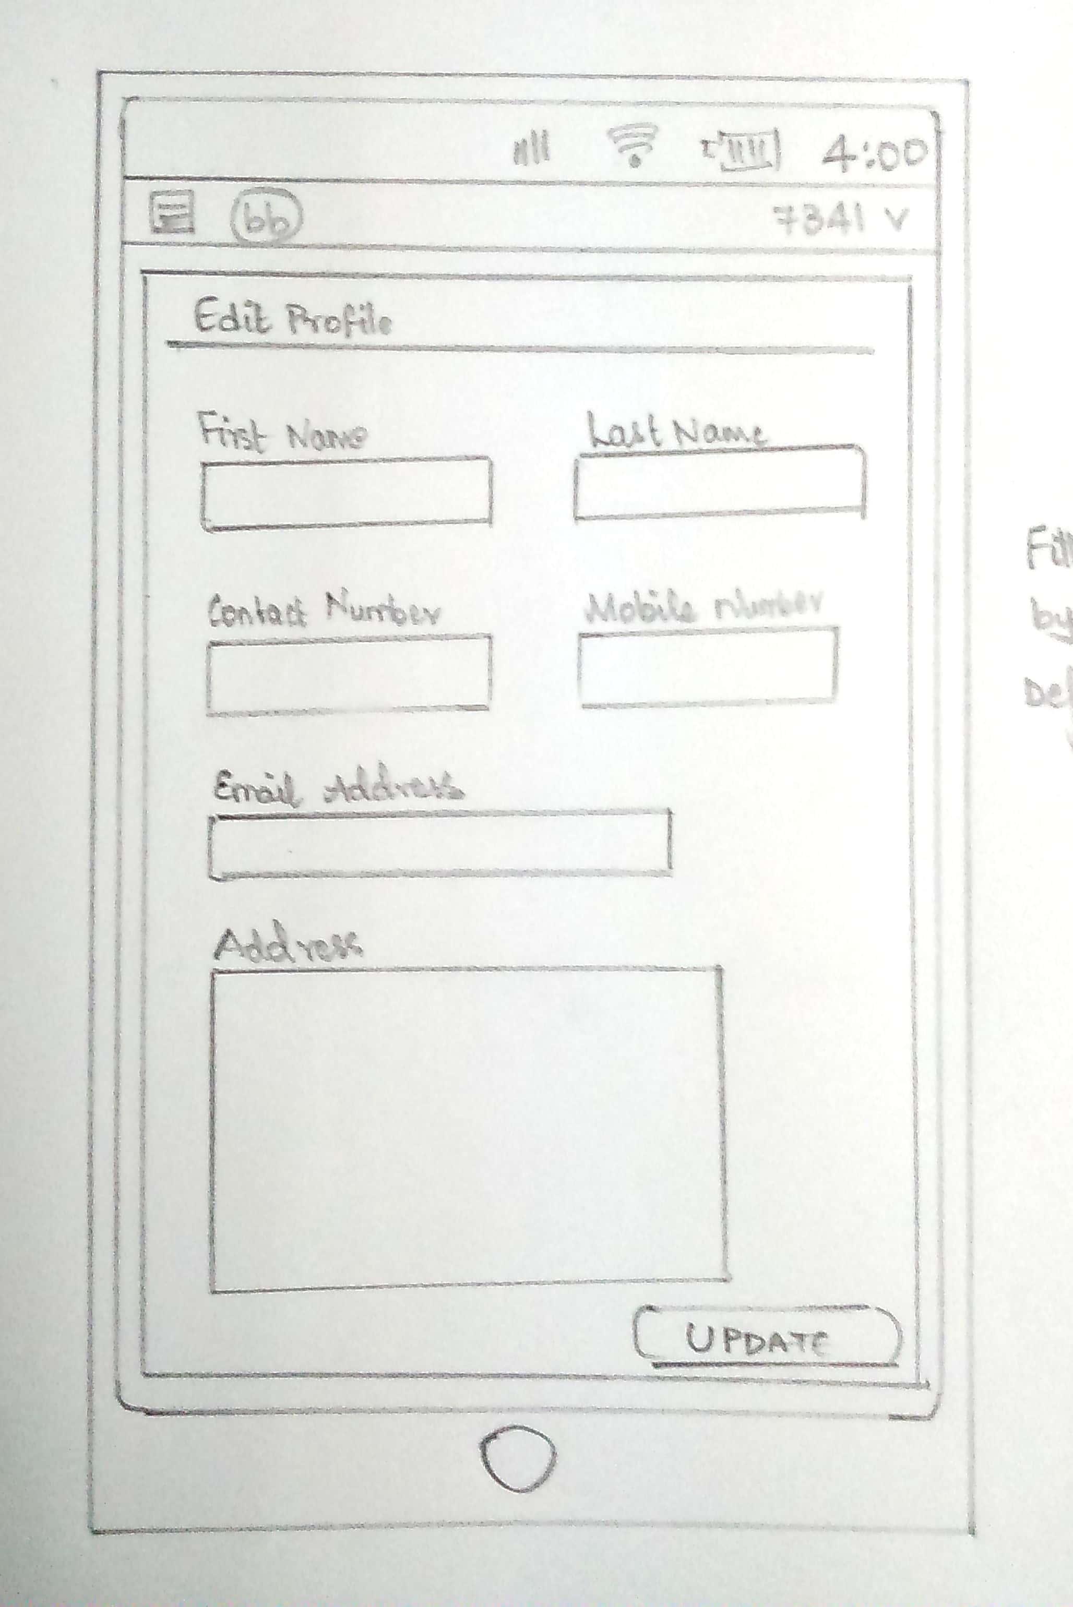
Sketches of the Screen Designs and User Flows…

Slide 23
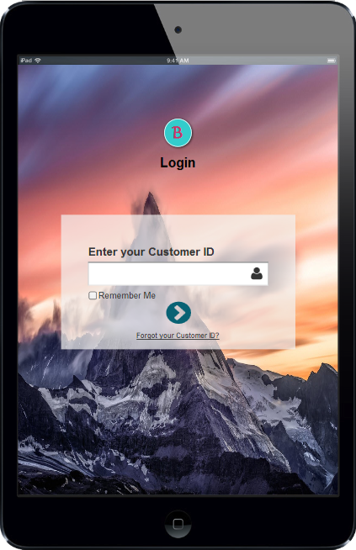
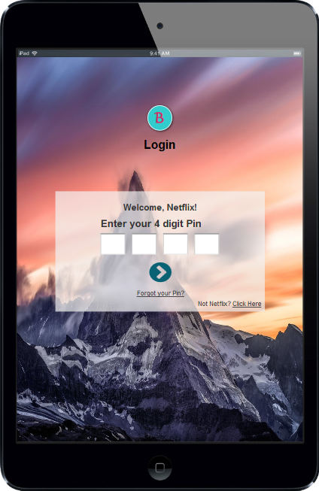

Slide 24
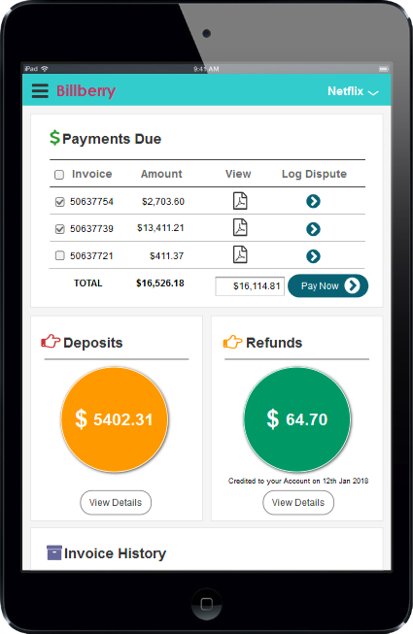
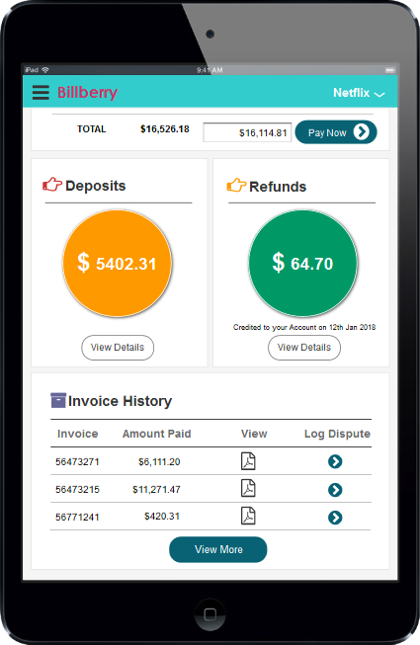

Slide 25
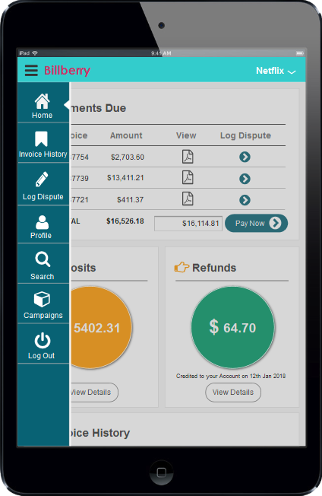
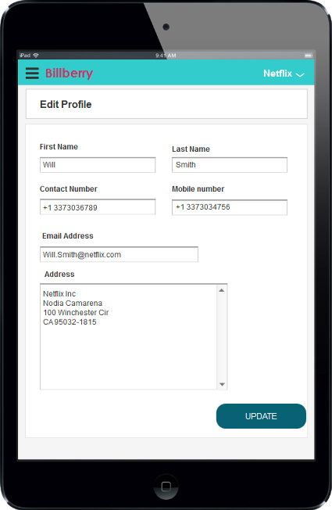

Slide 26
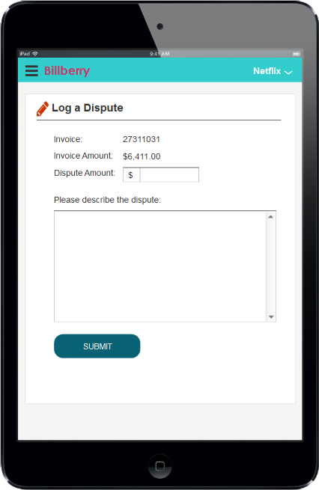
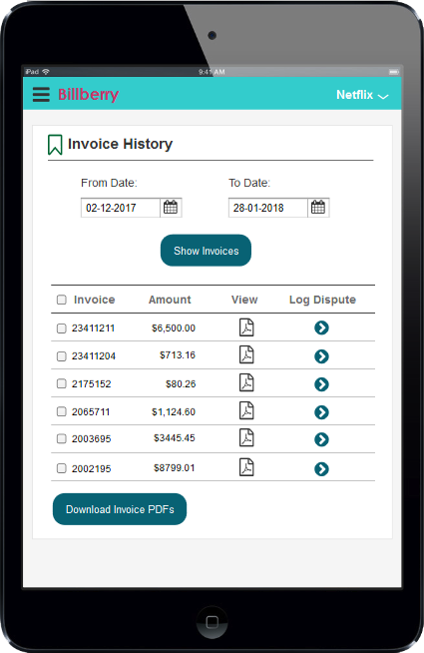

Slide 27
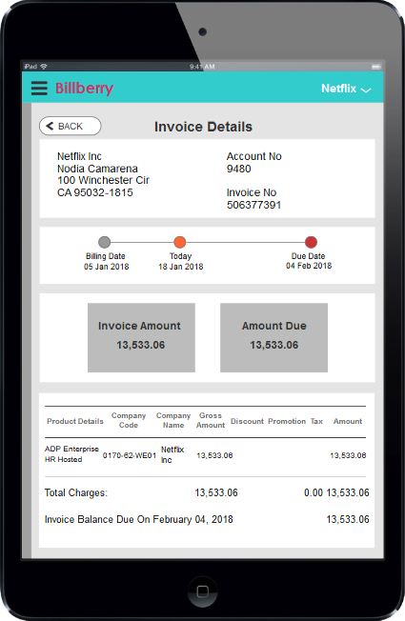
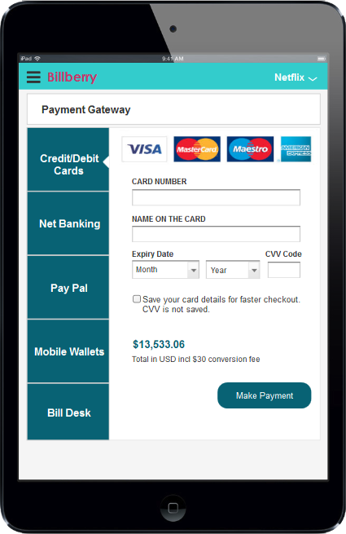

Slide 28
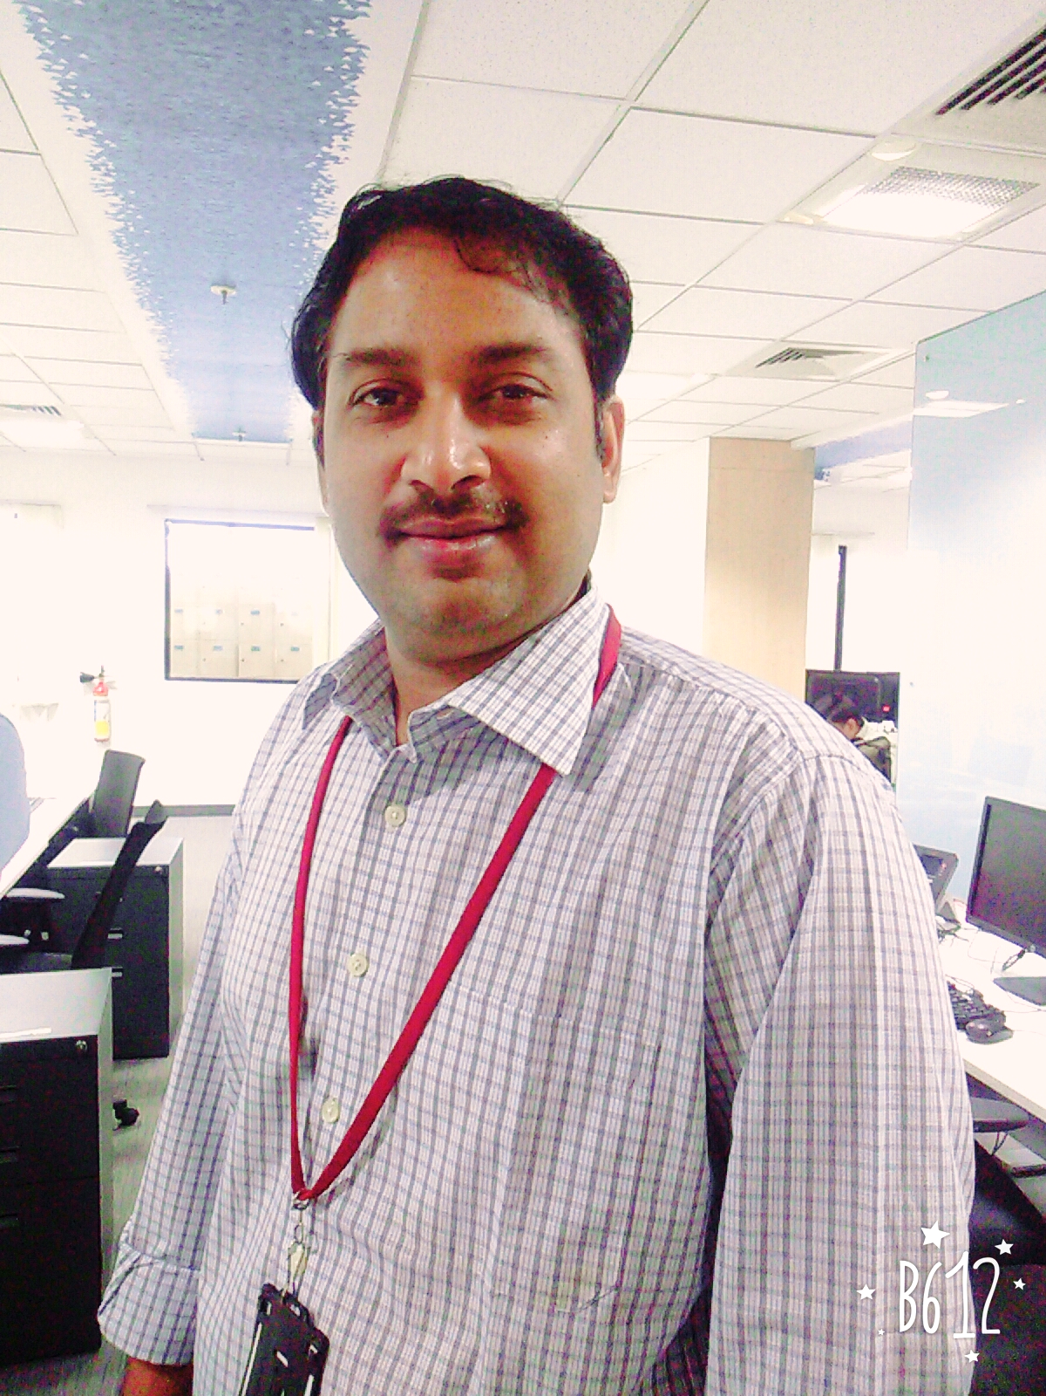
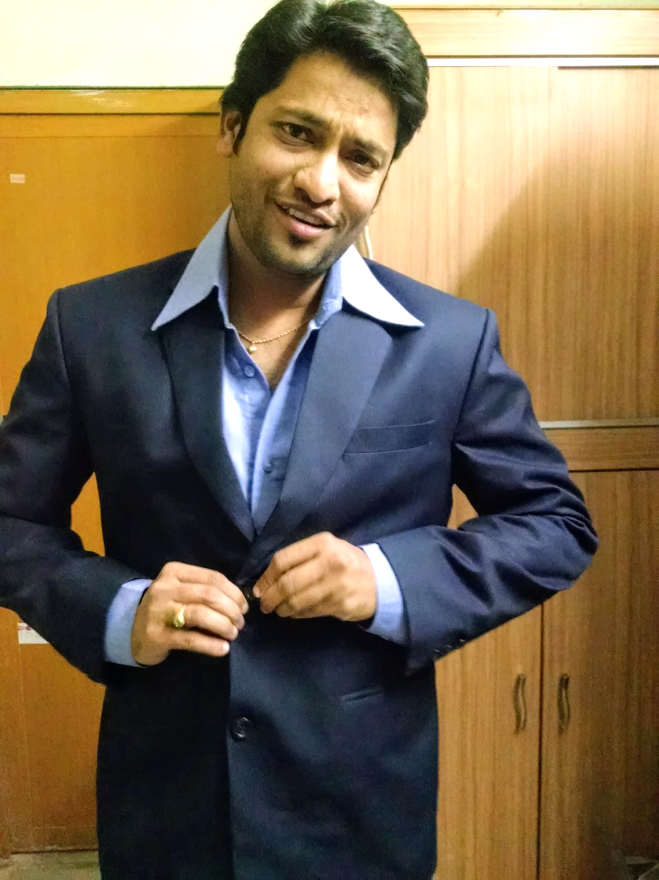
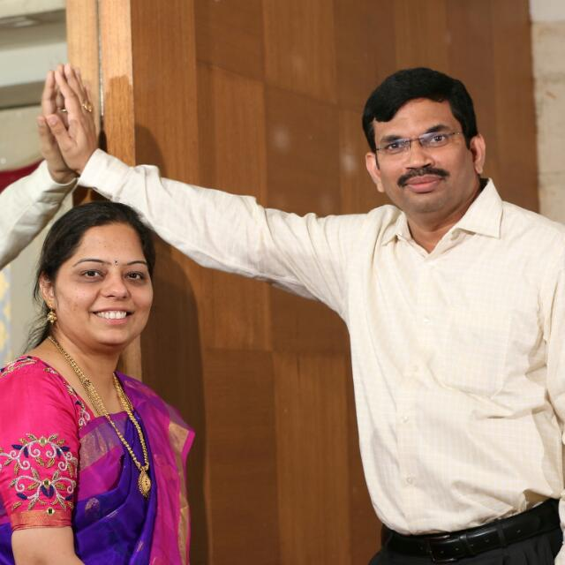
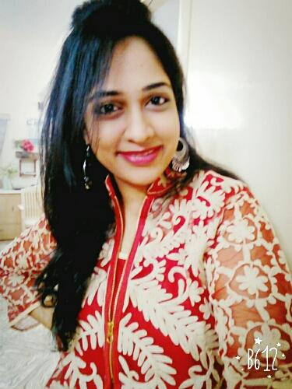
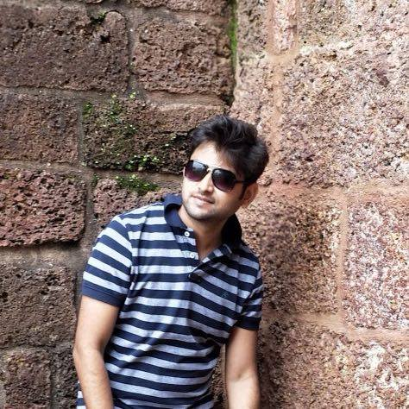
THE
IMPECCABLES
TEAM
Subbu
Raghu
Bala
Sana
Rahul

Slide 29
THANK YOU

